Slide 1
Global Imaging Network
Nathan Jacobs
Nathaniel Roman
Scott Satkin
Walker Burgin
Robert Pless
Washington University
Partially supported by
NSF Career award IIS-0546383

Slide 2

There already exists a free, global, network of thousands of cameras.
Today, at 4:44 pm.

Slide 3
How can we use these cameras?
We approach this problem using the paradigm of Passive Vision: what can we learn from many images from a static camera.

Slide 4
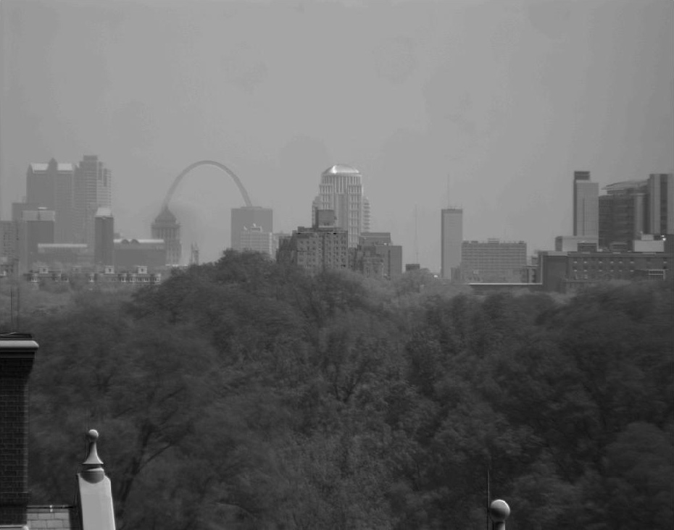
St. Louis (from my lab).

Slide 5
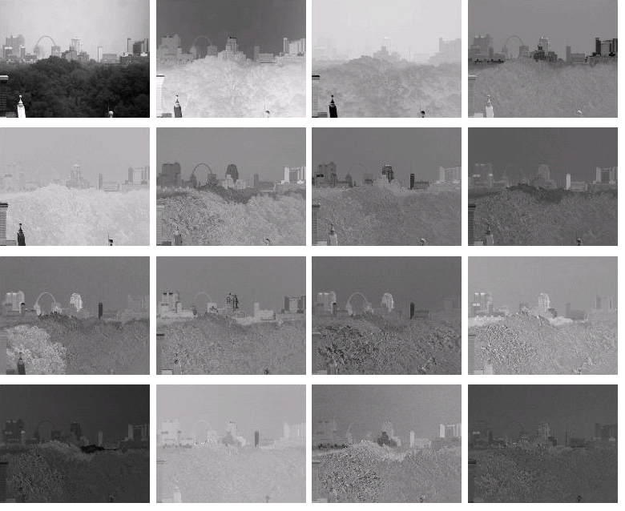

Slide 6
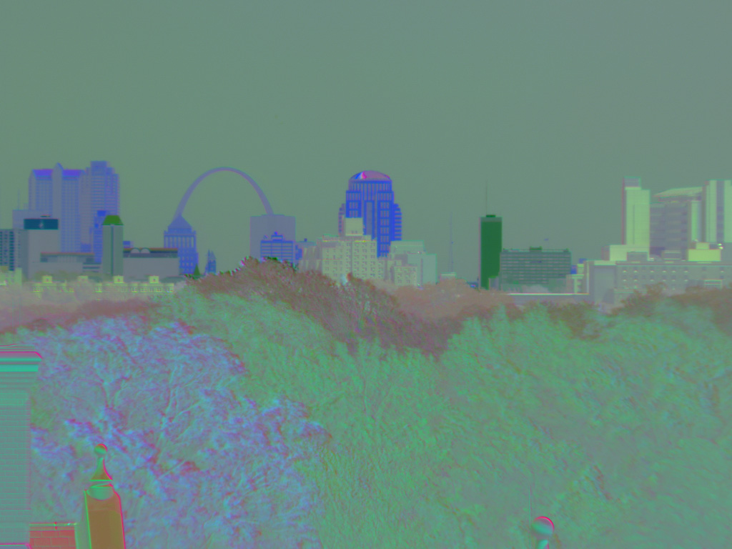
“Nearby” regions in the environment tend to co-vary
Blue: downtown
Dk. Green: SLU
Lt. Green: Med School
(False Color Image -R,G,B components are different principal components)

Slide 7
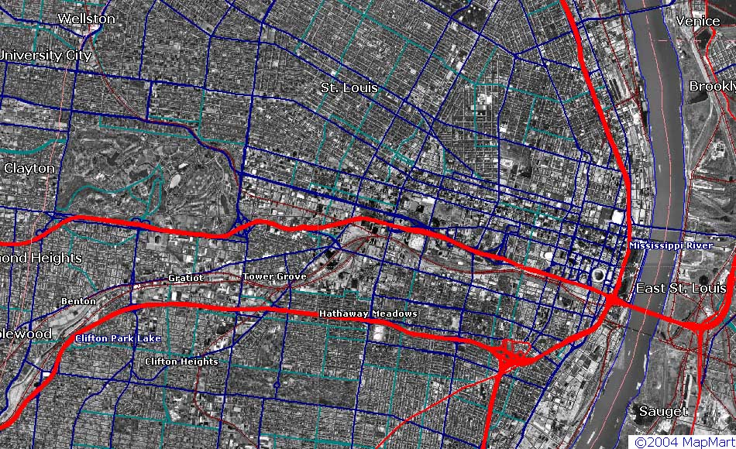
St. Louis Geography
Wash U. (Camera Location)
Med School
St. Louis University
Downtown/Arch

Slide 8
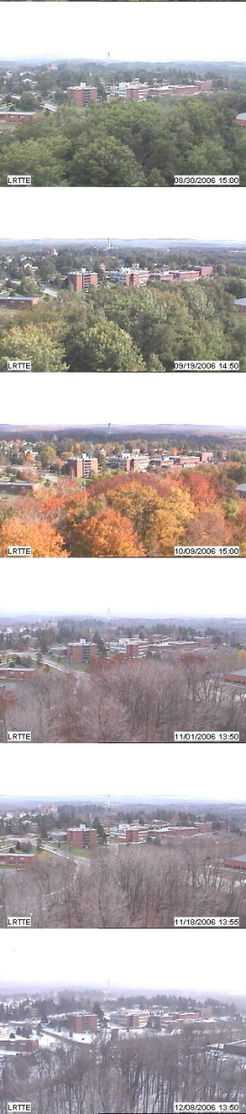
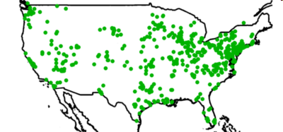
The Archive of Many Outdoor Scenes (AMOS)
Images from ~1000 static webcams,
every 30 minutes since March 2006.
www.cs.wustl.edu/amos
Variations
over a year and over a day
Capture variations from fixed cameras
due to lighting (time of day), and
seasonal and weather variations (over a year).
From cameras mostly in the USA (a few elsewhere).

Slide 9
Data

Slide 10
Related Work
WILD database
All the Images of an Outdoor Scene, Narasimhan, Wang, Nayar, ECCV 2002
“Clustering Appearance for Scene Analysis”, Koppal, Narasimhan, CVPR 2006
Time Lapse
Factored Time-Lapse Video, Sunkavalli, Matusik, Pfister, Rusinkiewicz, SIGGRAPH 2007.
What do Color Changes Reveal about an Outdoor Scene?, Sunkavalli, Romeiro, Matusik, Zickler, Pfister, CVPR 2008
Radiometric Calibration with Illumination Change for Outdoor Scene Analysis, Kim, Frahm, Pollefeys, CVPR 2008.

Slide 11
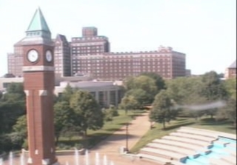
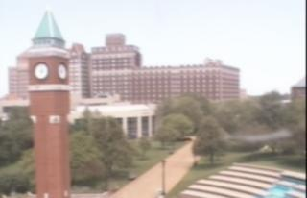
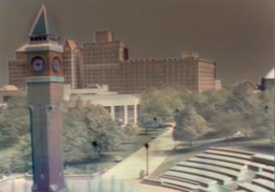
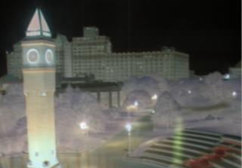
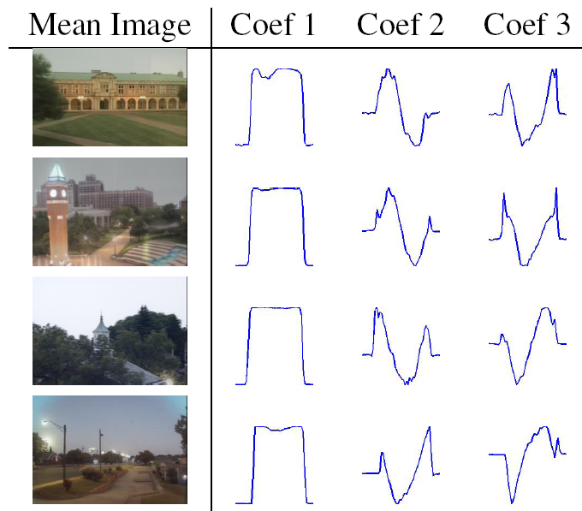
= + f₁(t,x) + f₂(t,x) + ...
Mean Image
Component 1
Component 2
Camera 1
Camera 2
Camera 3
Camera 4

Slide 12
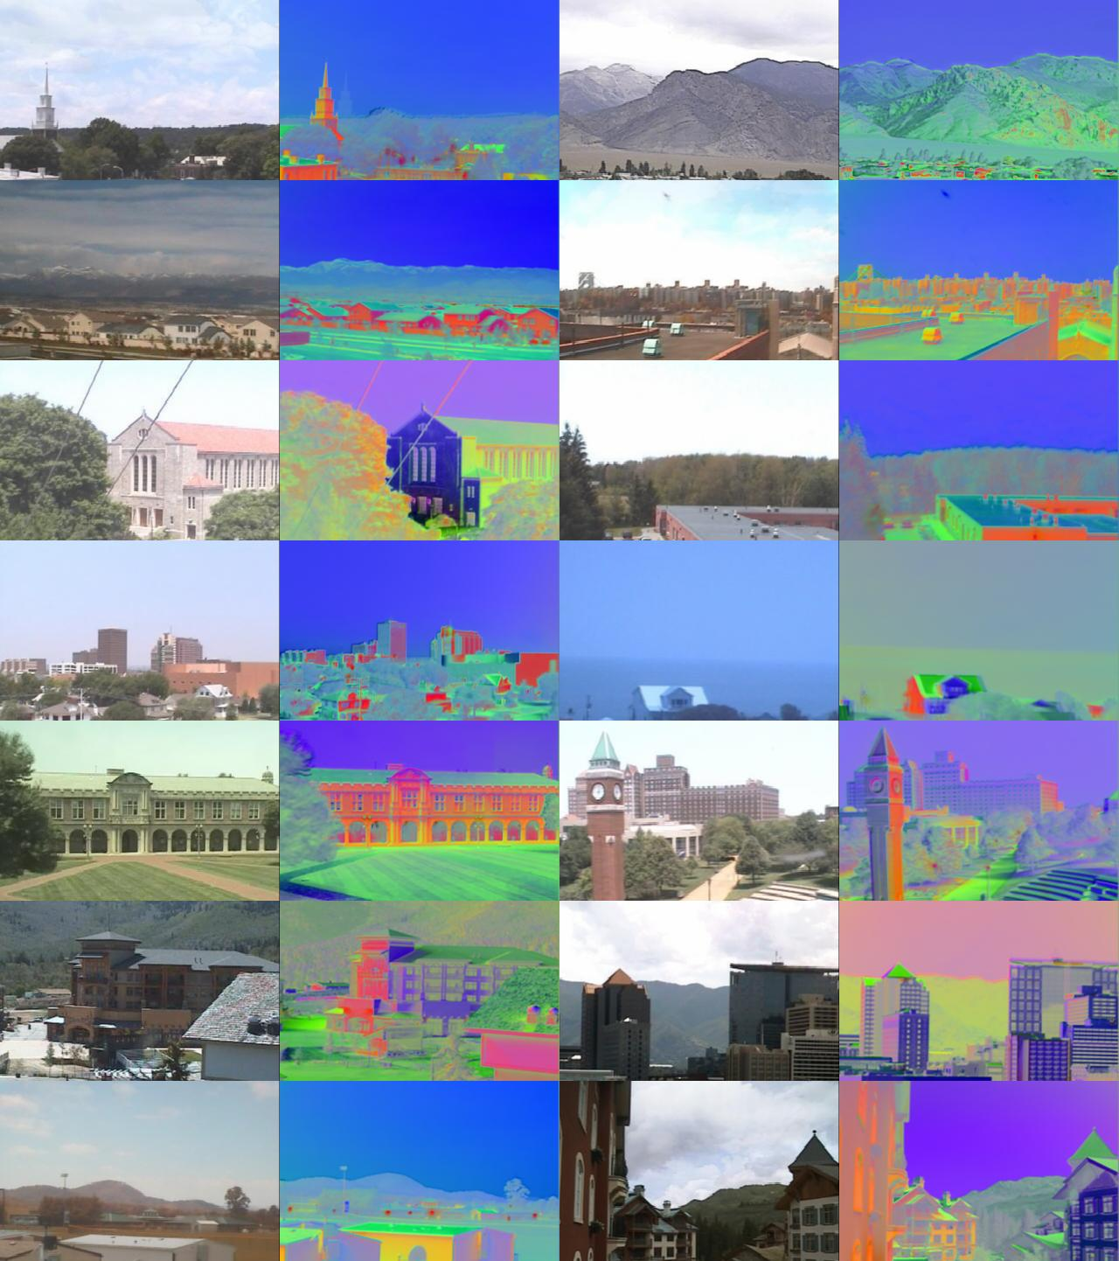
Canonical Day Components
“Consistent Temporal Variations in Many Outdoor Scenes”
Jacobs, Roman, Pless, CVPR 2007

Slide 13
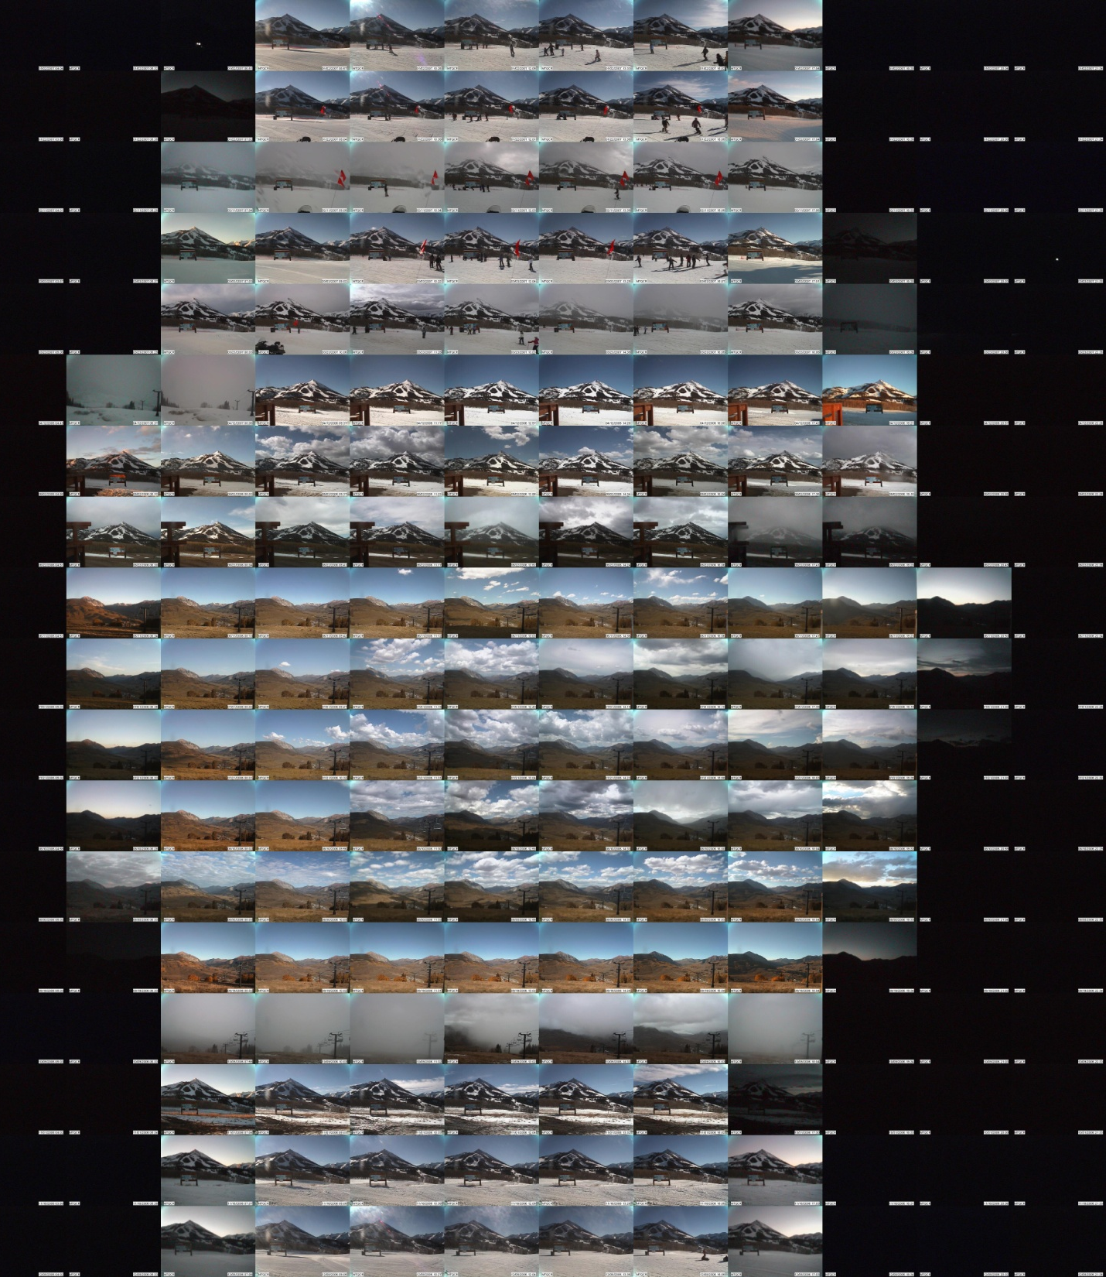

Slide 14
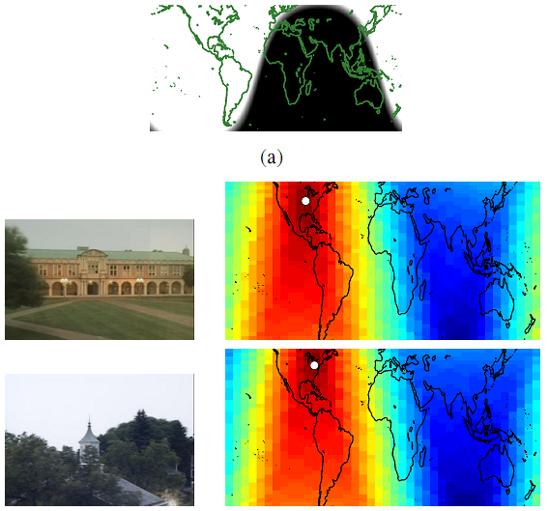
Geo-location Algorithm Overview
1. Compute principal component coefficients of a set of images from the camera for a given time period (~1 month)
2. Create a global appearance map for each time when an image was taken.
3. Try to reconstruct each map pixel, using the leading coefficients trajectories from the image set.
4. The map pixel with the highest correlation with the reconstruction is the estimate of the location of the camera.

Slide 15
Localization using sunlight image

Slide 16
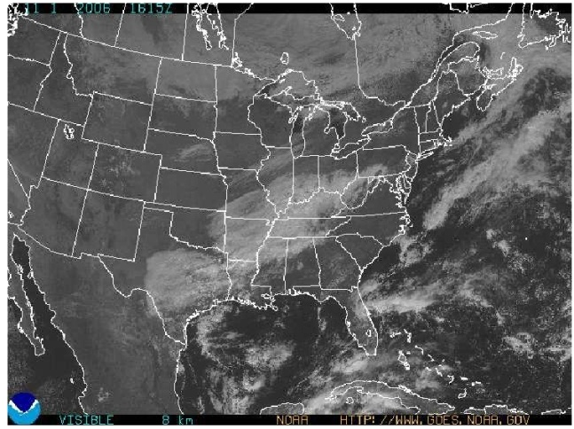
Localization using satellite/weather.

Slide 18
Relative Camera Localization
The linear relationship between distance and canonical correlation.

Slide 19
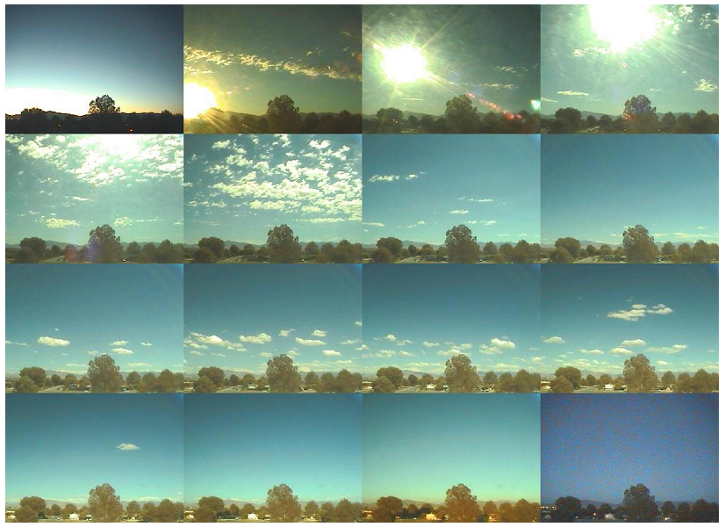
Camera orientation

Slide 20
Geo-orientation algorithm
Assume that camera location is known.
Find pixels that image sky.
Create full hemispherical sky-appearance image (from analytic model) for that geographic location at each image capture time.
Find part of hemispherical sky-appearance model that best correlates with sky pixels.

Slide 21
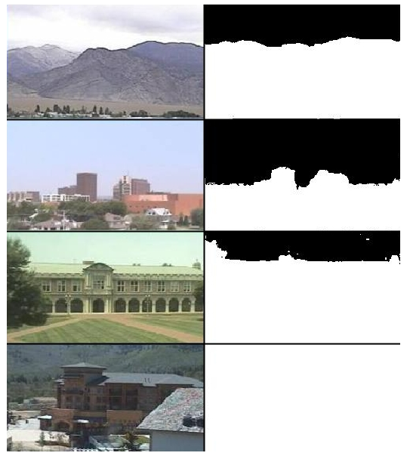
Part 1: Sky Segmentation
Algorithm:
Solve for component images using the canonical coefficient trajectories (shown below). Threshold each pixel on the value of component 1.

Slide 22
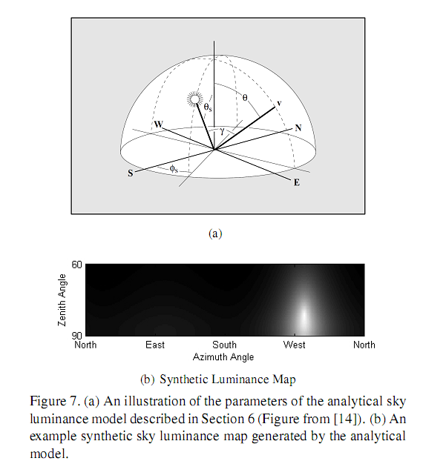
Hemispherical Synthetic Sky Image
Given specific time (when the image was captured) and the camera location, we compute the direction to the sun, and create the geo-oriented synthetic sky image.
Preetham et al. “A practical model for daylight”, SIGGRAPH ’99.

Slide 23














simulated
Rectangular sub-images

Slide 24
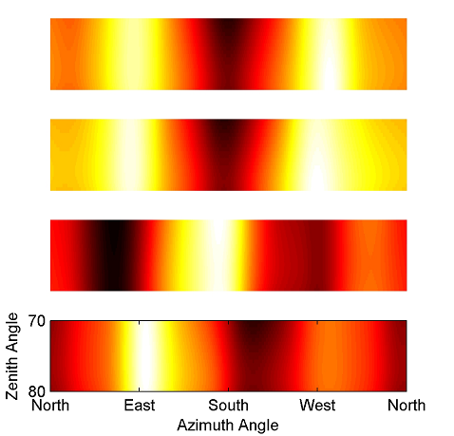
Results
Normalized Cross Correlation between synthetic panorama and real image.
Using 1 weeks worth of daytime images.
Westward facing camera
Same camera, sun images dropped
South facing camera
Large field of view camera.

Slide 25
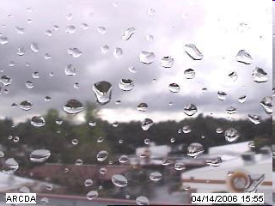
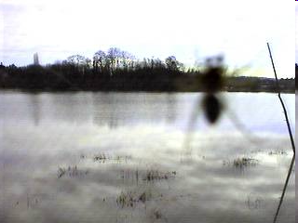
Is the camera static?
Cameras have crazy failure modes, and not all cameras remain static.
Camera motion detection is especially hard when images are captured every 30 minutes.
This may be a problem unique to our data set, and we have a two stage detection:
Filter using mutual information compared to previous day image
If this fails then use SIFT to solve for homography. If homography is not close to identity, then mark camera as moved.

Slide 26
Conclusions/Future Work
Global image variations in natural scenes give strong cues for camera location and orientation.
Can we solve for more complete camera calibration (with better models of sky luminance and reasoning about atmospheric conditions)?
Can we solve for more accurate camera calibration with higher frame rates?

